Slide 1
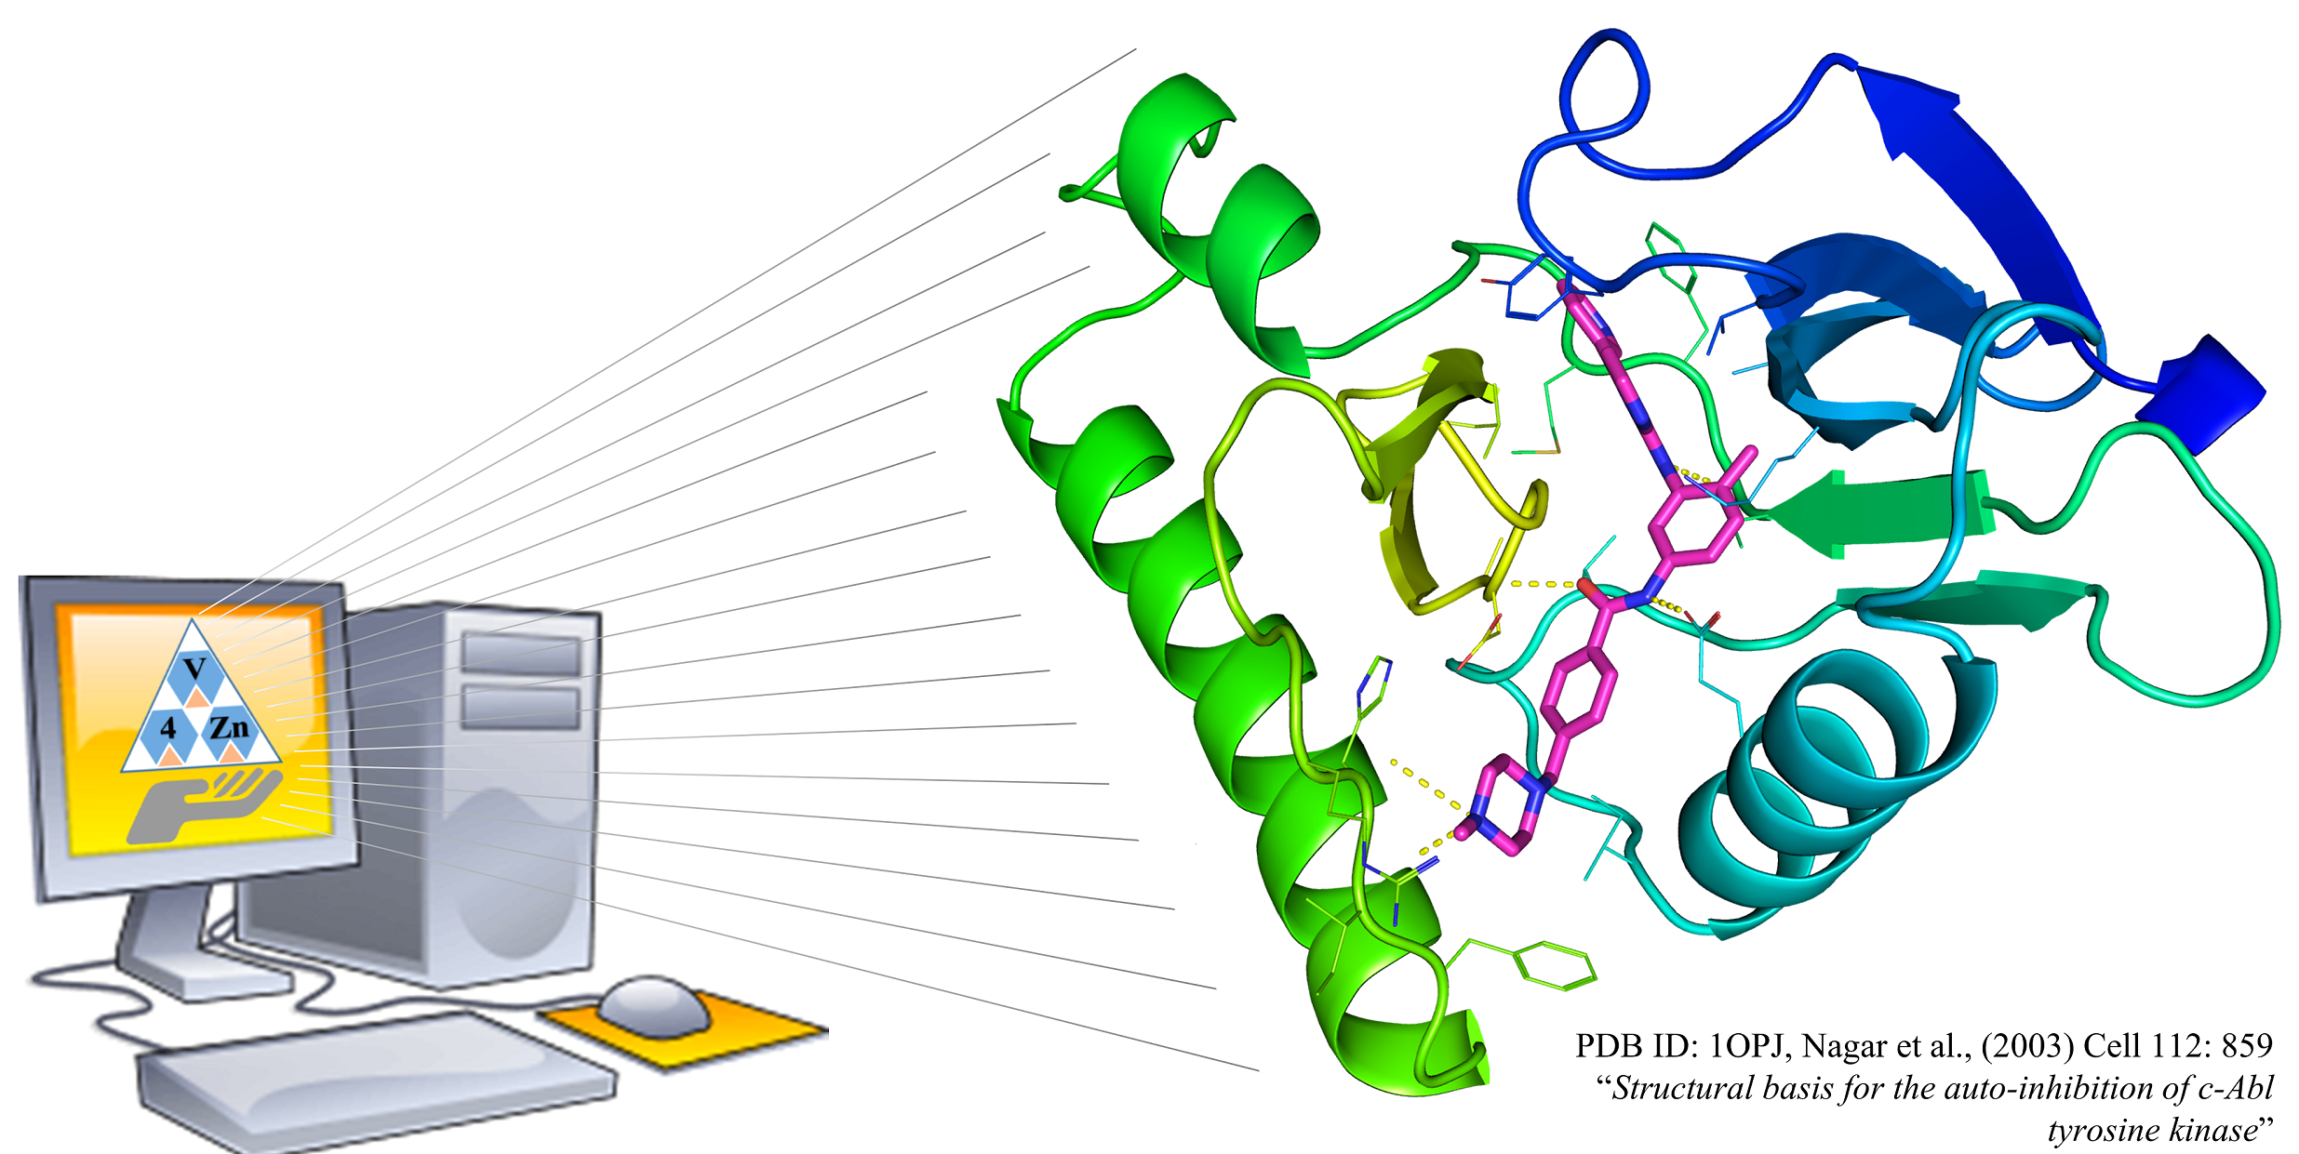
AMDock
Assisted Molecular Docking with
AutoDock Vina and AutoDock4
USER MANUAL

Slide 2
Figure 1. Workflow in AMDock

Slide 3
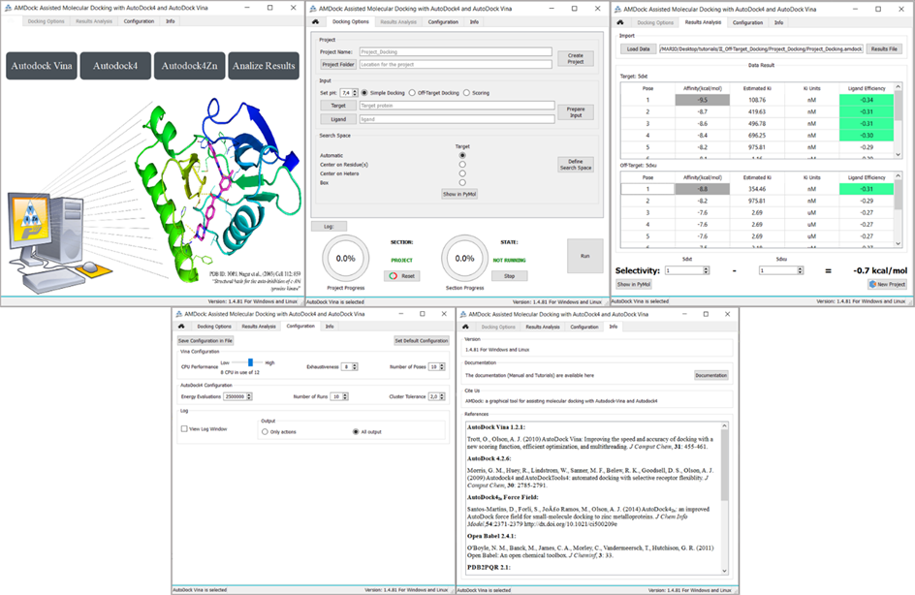
Figure 2. AMDock components. From left to right: Home, Docking Options, Results Analysis, Configuration and Info.

Slide 4
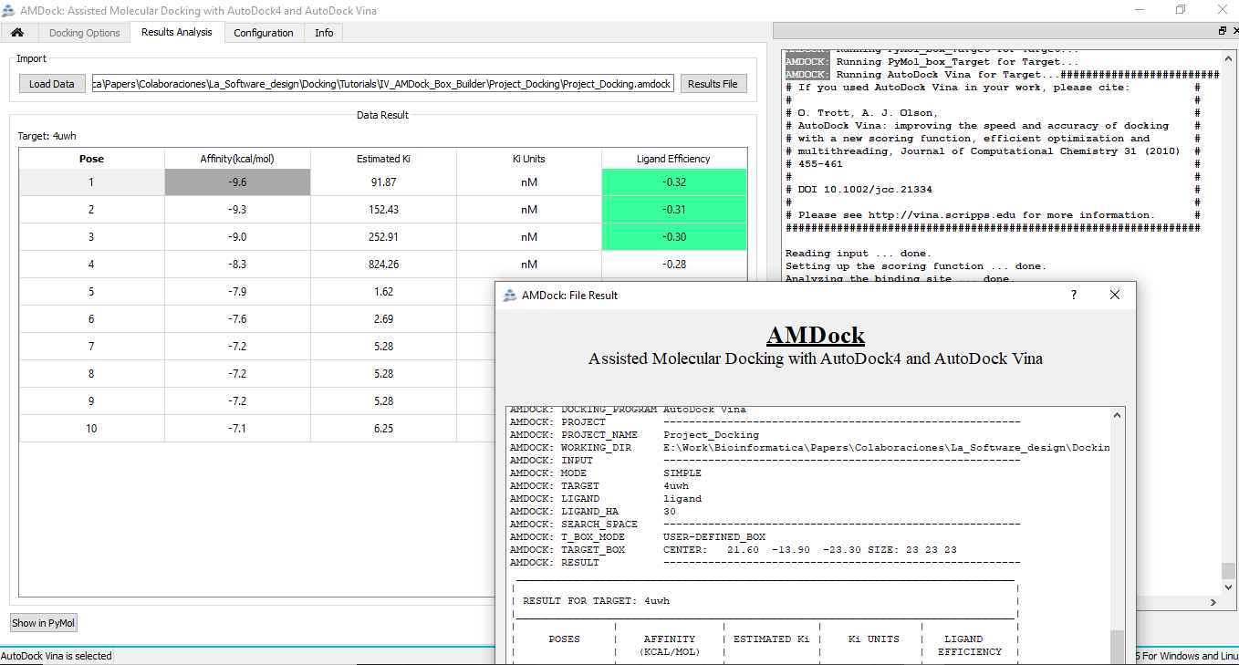
Figure 3. AMDock Result Analysis Tab. Behind left to right: Result table and Log record. The AMDock output table is shown in the front.

Slide 5
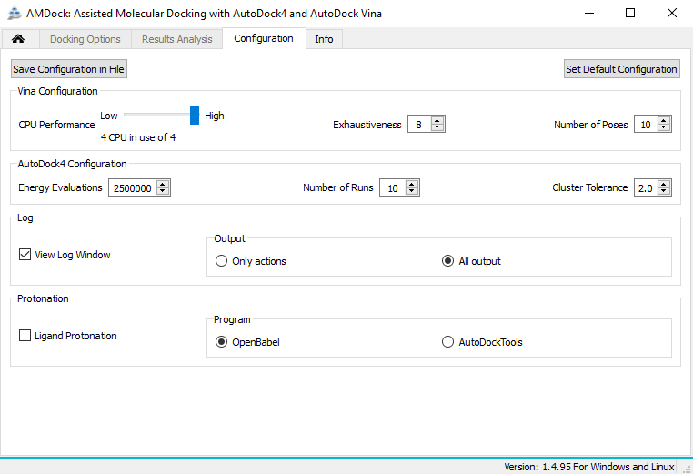
Figure 4. AMDock Configuration Tab.

Slide 6
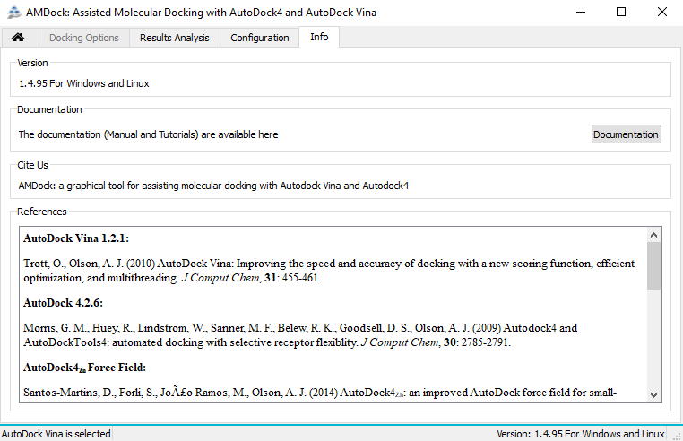
Figure 5. AMDock Info Tab.

Slide 7
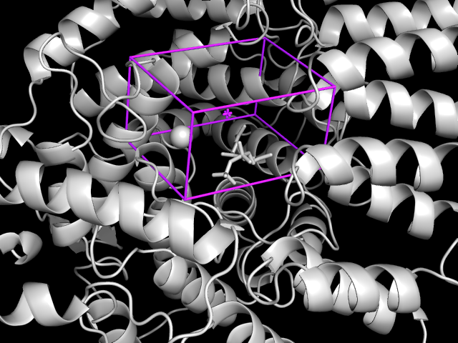
Figure 6. Custom Box. The protein (farnesyltransferase) is represented in cartoon and gray color. Note that the Zn atom and the cofactor are also represented, in sphere and sticks respectively. The box is shown in cylinders and magenta color.

Slide 8
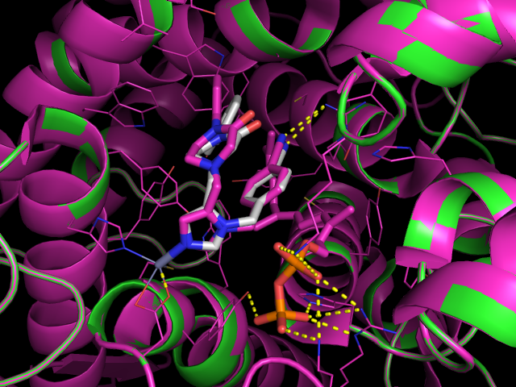
Figure 7. Superposition of the predicted complex from custom box using AutoDock4Zn with a reference complex (PDB ID: 1S63). Receptor is represented as cartoon while X-ray and predicted ligand binding pose are repreented as white and magenta sticks respectively.

Slide 9
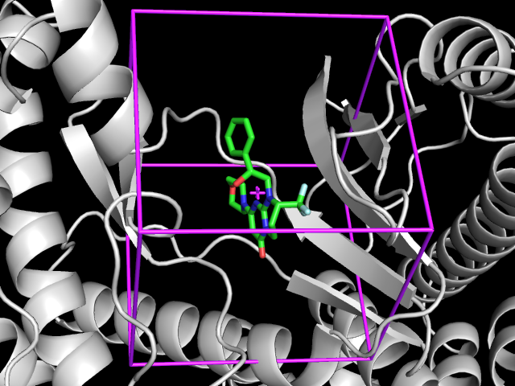
Figure 8. Box Centered on Hetero. The protein (Vps34) is represented in cartoon and gray color and previous ligand in green sticks. The box is shown in cylinders and magenta color.

Slide 10
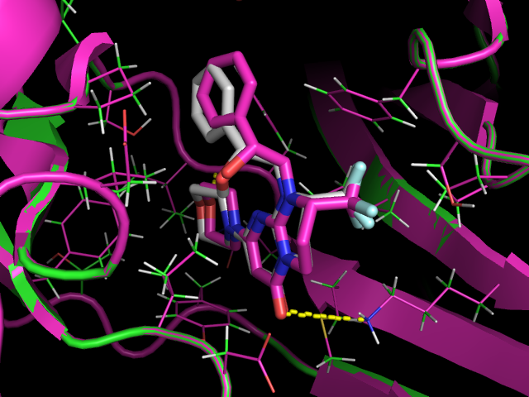
Figure 9. Superposition of predicted complex from box Centered on Hetero with a reference complex (PDB ID: 4UWH). Receptor is represented as cartoon while X-ray and predicted ligand binding pose are repreented as white and magenta sticks respectively.

Slide 11
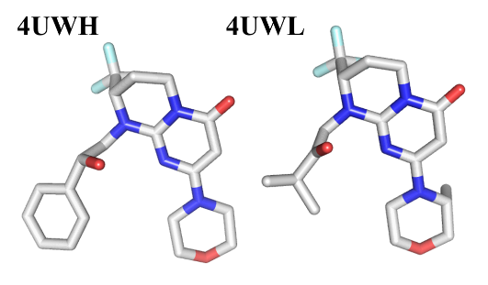
Figure 10. Vps34 inhibitors with similar structure.

Slide 12
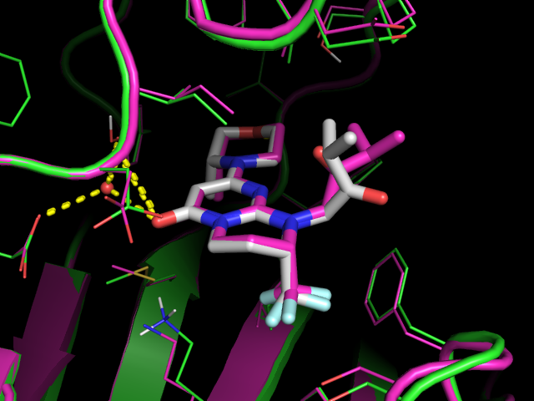
Figure 11. Superposition of predicted complex from box Centered on Hetero with a reference complex (PDB ID: 4UWL). Receptor is represented as cartoon while X-ray and predicted ligand binding pose are repreented as white and magenta sticks respectively.

Slide 13
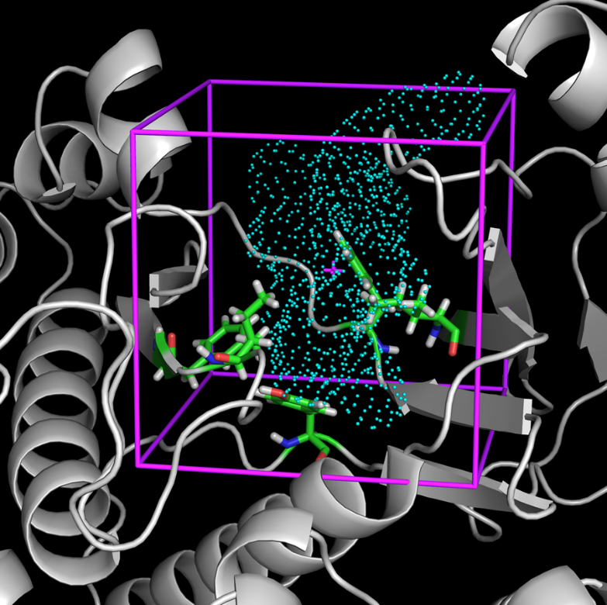
Figure 12. Box Centered on Residues. The protein (Vps34) is represented in gray cartoon, the selected residues in green sticks and the object generated by AutoLigand in cyan dots. The box is shown in magenta cylinders

Slide 14
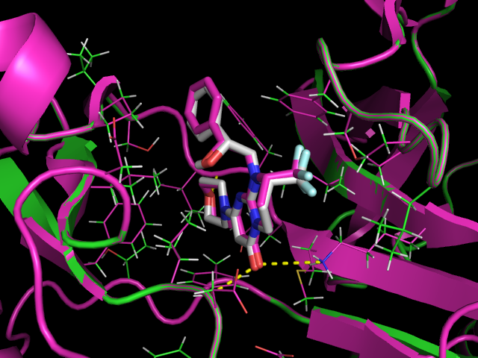
Figure 13. Superpsition of predicted complex from box Centered on Residue(s) with a reference complex (PDB ID: 4UWH). Receptor is represented as cartoon while X-ray and predicted ligand binding pose are repreented as white and magenta sticks respectively.

Slide 15
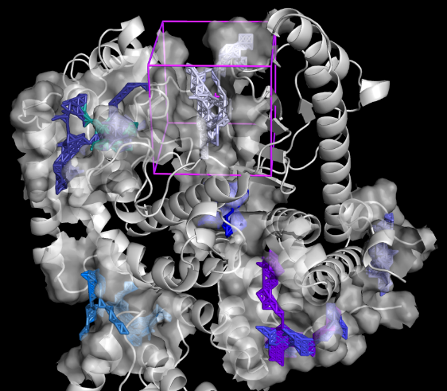
Figure 14. Automatic mode Search Space determination. The protein (Vps34) is represented gray cartoon. Each binding site predicted by AutoLigand is repsented as transparent surface and also contains an object represented as sticks. The box is shown in cylinders and magenta color. Only one box is shown for better clarity.

Slide 16
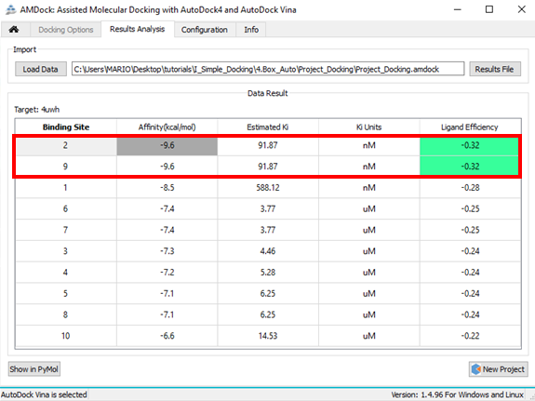
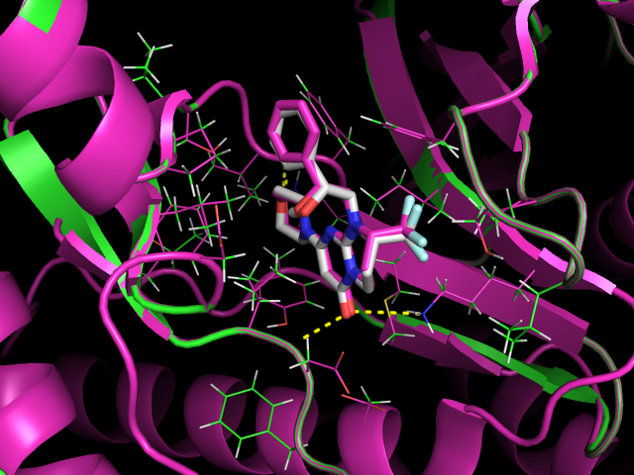
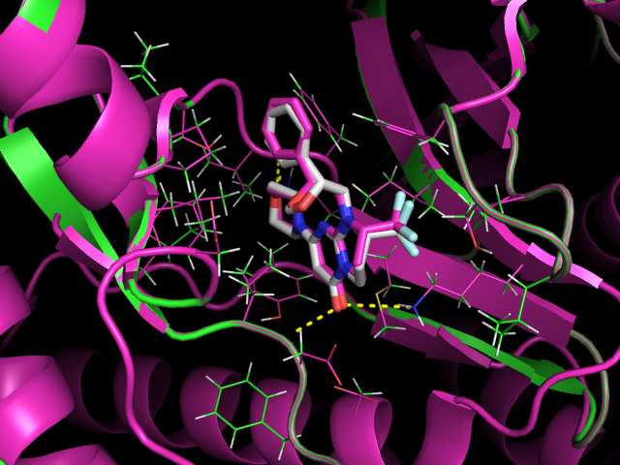
Figure 15. Results from Automatic mode selection. Up: The table show the sorted list of affinity for each predicted binding site. Down: Superpsition of predicted complex from predicted site 2 (left) and 9 (rigth) with a reference complex (PDB ID: 4UWH). Receptor is represented as cartoon (green) while X-ray and predicted ligand binding pose are represented as white and magenta sticks respectively.

Slide 17
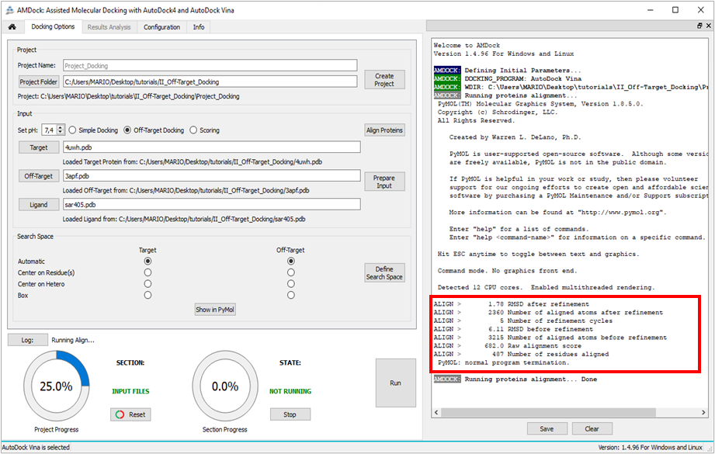
Figure 16. Proteins alignment from “Off-Target Docking”. The red box highlights the alignment results from PyMOL.

Slide 18
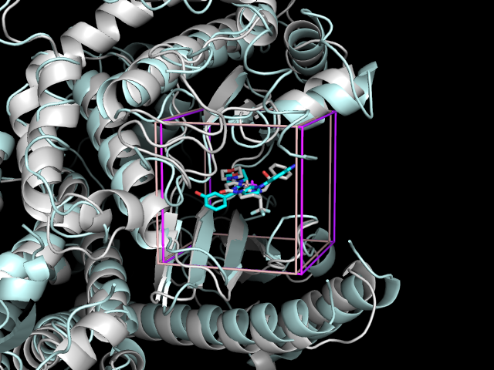
Figure 17. Search space definition in Target (Vps34) and Off-Target (PI3Kγ). Both boxes are Centered on Hetero.

Slide 19
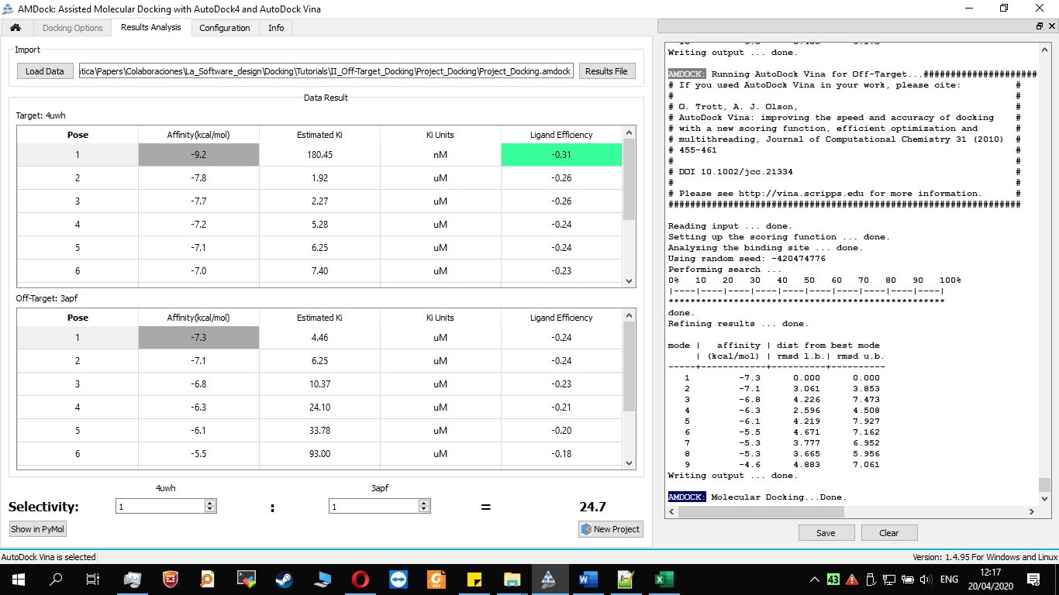
Figure 19. Off-Target Docking results format of SAR405 againts Vps34 and PI3Kγ. The best pose of SAR405 in complex with Vps34 has an affinity of -9.2 kcal / mol, while with gamma it is -7.3 kcal / mol. According to the experimental data, SAR405 has a higher affinity (~ 25 times) for Vps34 than for PI3Kγ.

Slide 20
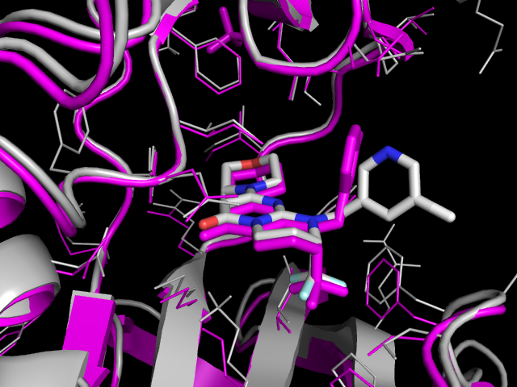
Figure 19. Superposition of predicted complex Vps34-SAR405 and a reference structure (PDB ID: 4UWL) (magenta).

Slide 21
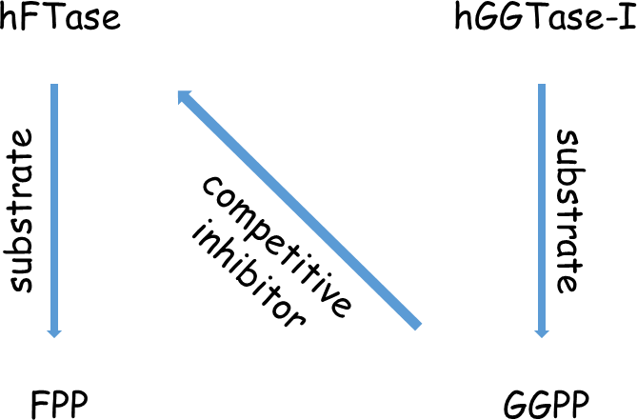
Figure 20. Diagram showing the relationship between enzymes and their cognates substrates and inhibitors.

Slide 22
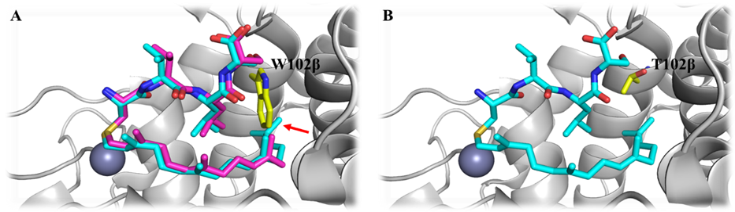
Figure 21. Farnesyl transferase ligand site. (A) Superposition of FPP-CVLS (magenta) and GGPP-CVLS (cyan), in wild-type hFTase active site. Red arrow indicates the steric clash between GGPP and W102β residue in the hFTase active site (B) GGPP-CVLS (cyan), in mutant hFTase W102βT active site. The mutation W102βT allows GGPP to fit into the active site of hFTase.

Slide 23
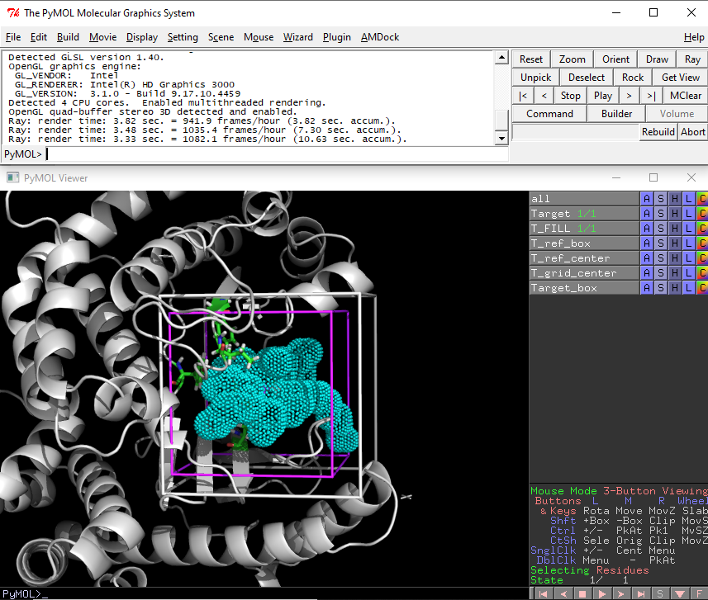
Figure 22. The specifications of the new box (Target_box (white)) from a predefined box (T_ref_box (magenta)) centered on Residue(s).

Slide 24
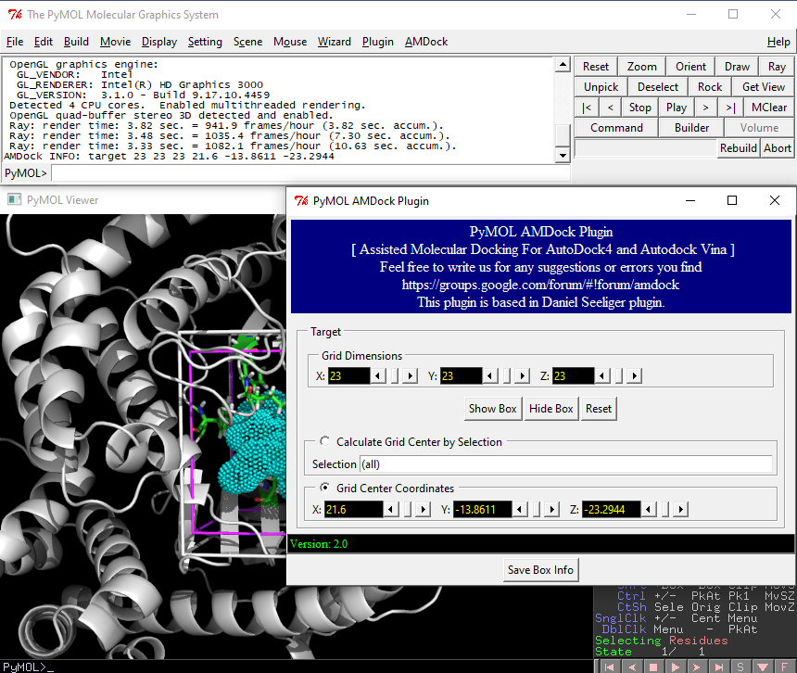
Figure 23. Instructions for saving box information.

Slide 25
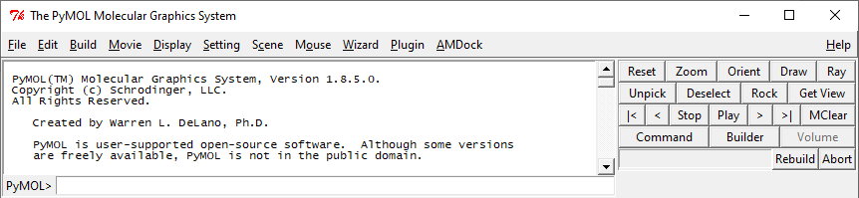
5
1
3
2
4
Figure 24. Instructions for saving scene images.

Slide 26
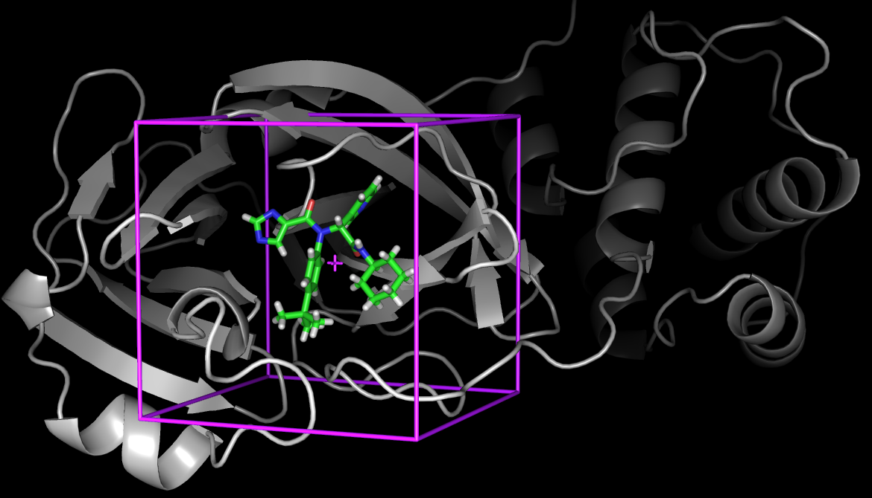
Figure 25. Box Centered on X77.

Slide 27
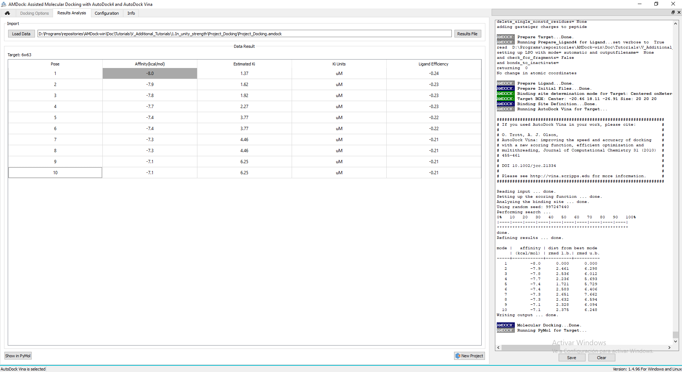
Figure 26. Results from Autodock Vina.

Slide 28
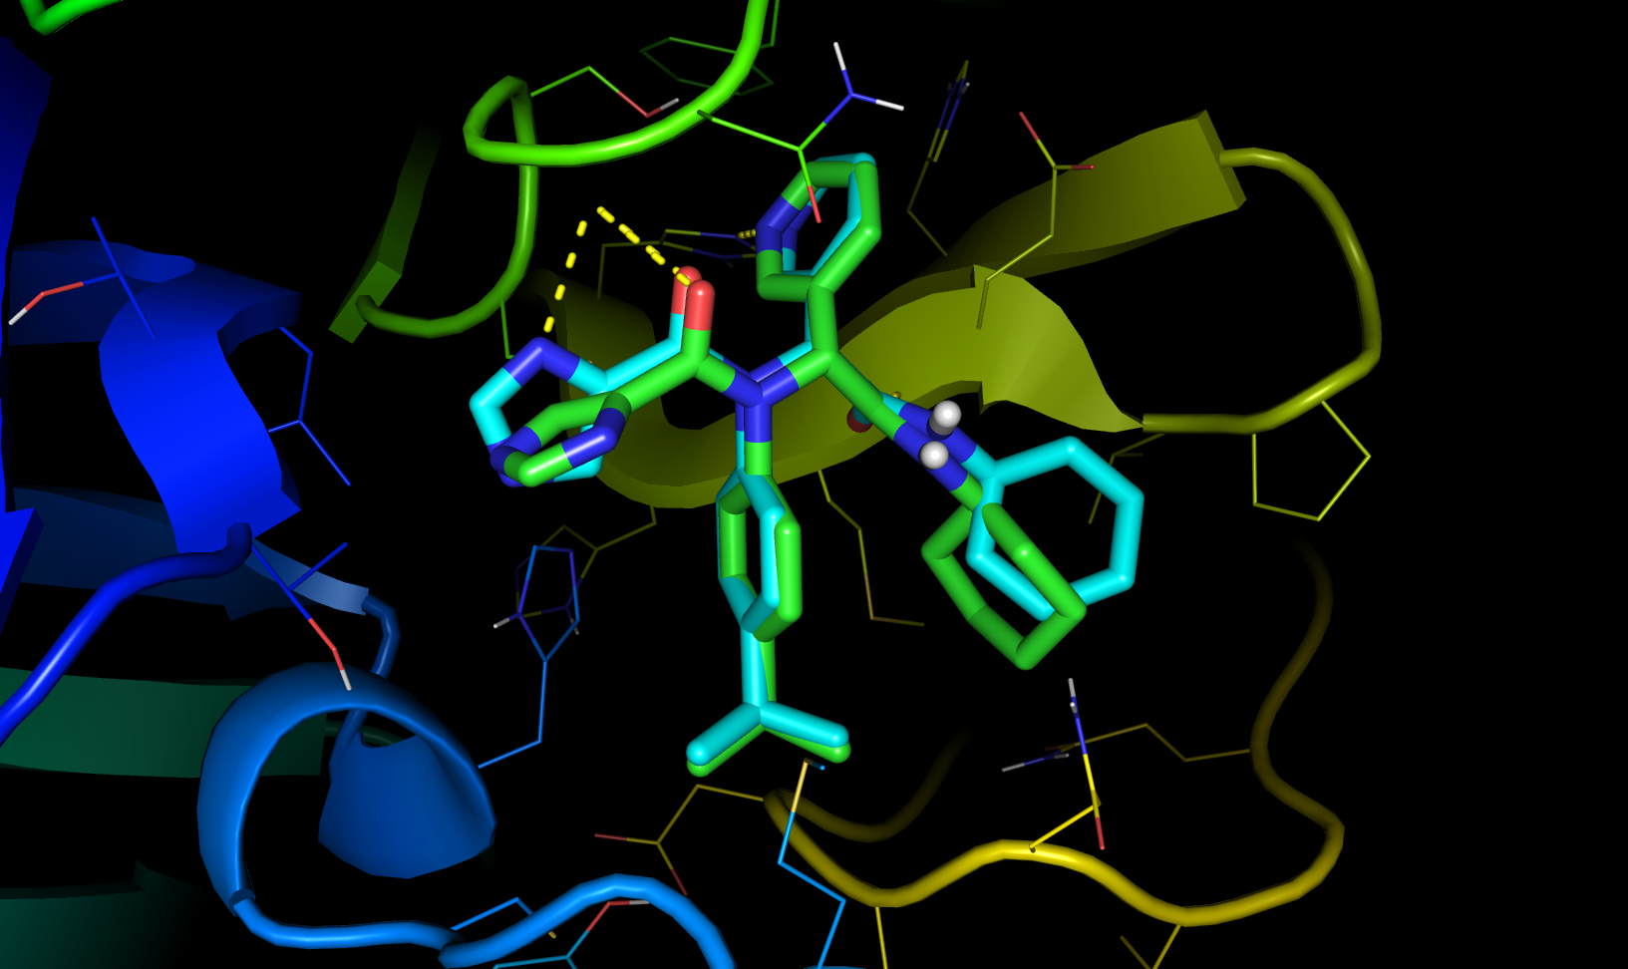
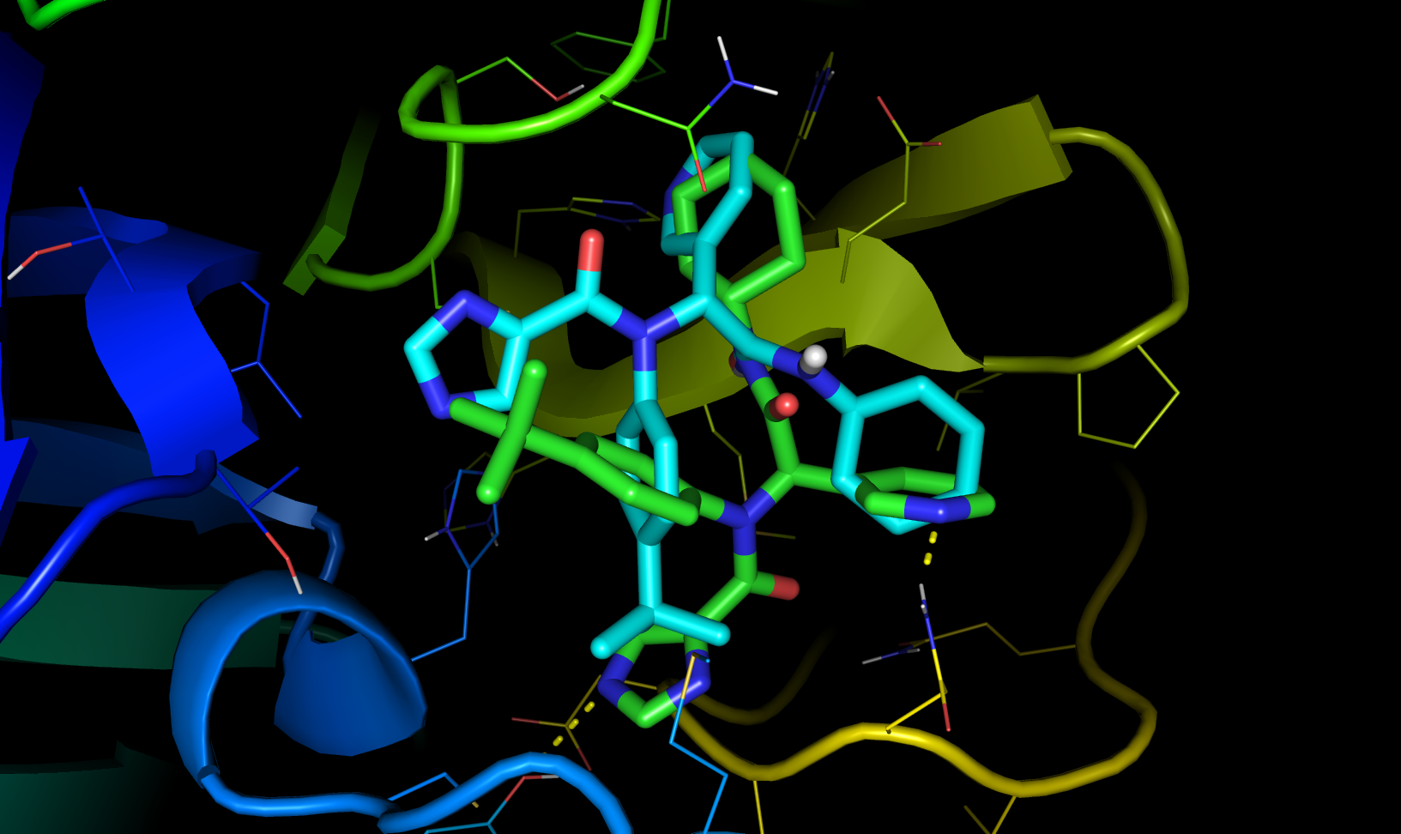
Figure 27. Predicted poses from Autodock Vina.

Slide 29
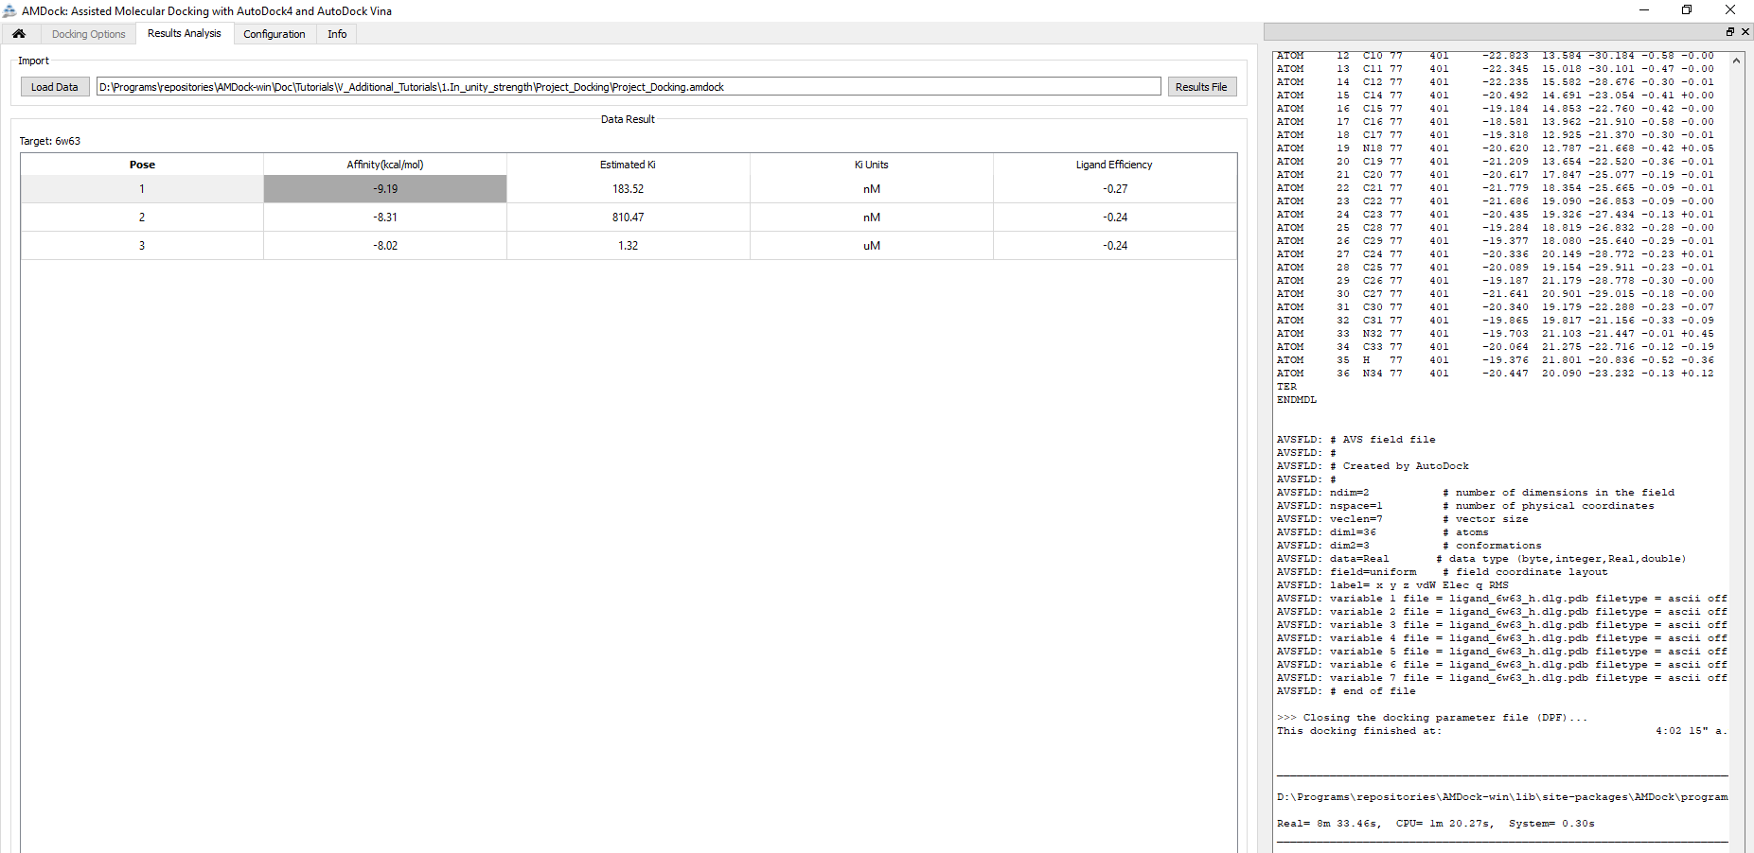
Figure 28. Results from Autodock4.

Slide 30
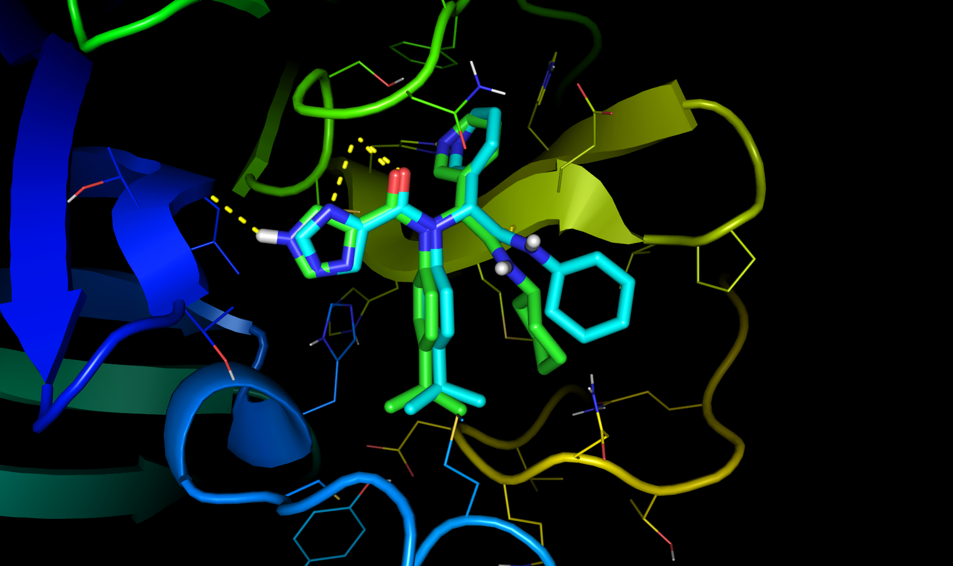
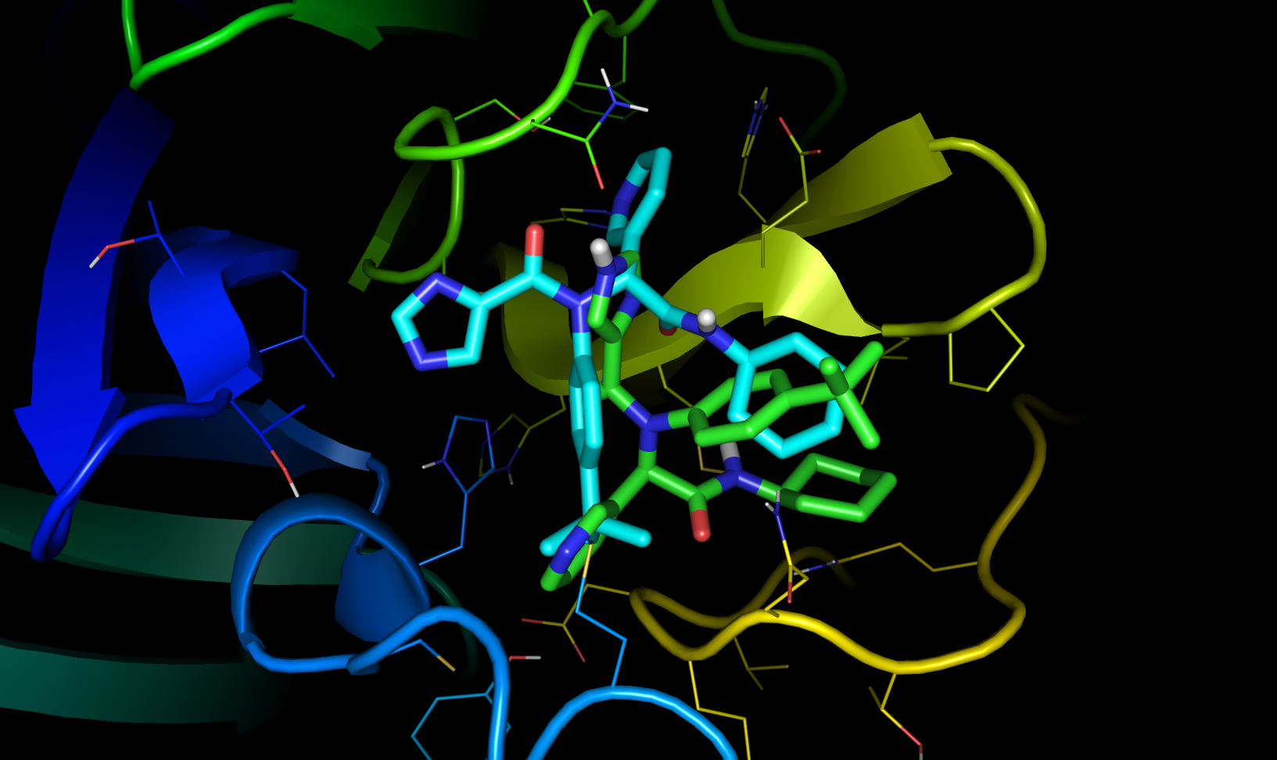
Figure 29. Predicted poses from Autodock4.

Slide 31
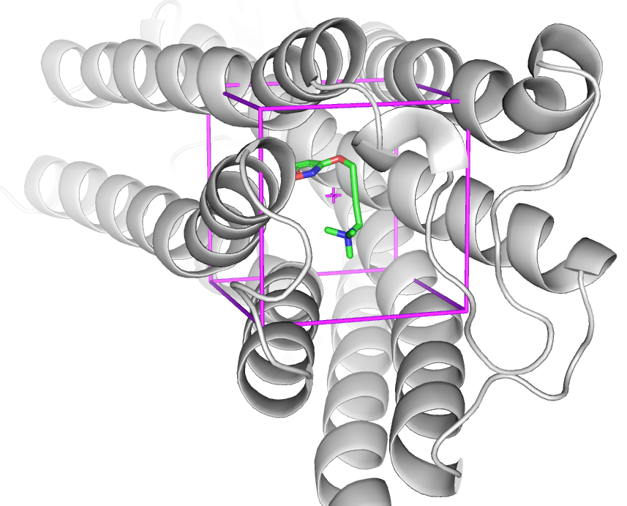
Figure 30. Box Centered on IXO.

Slide 32
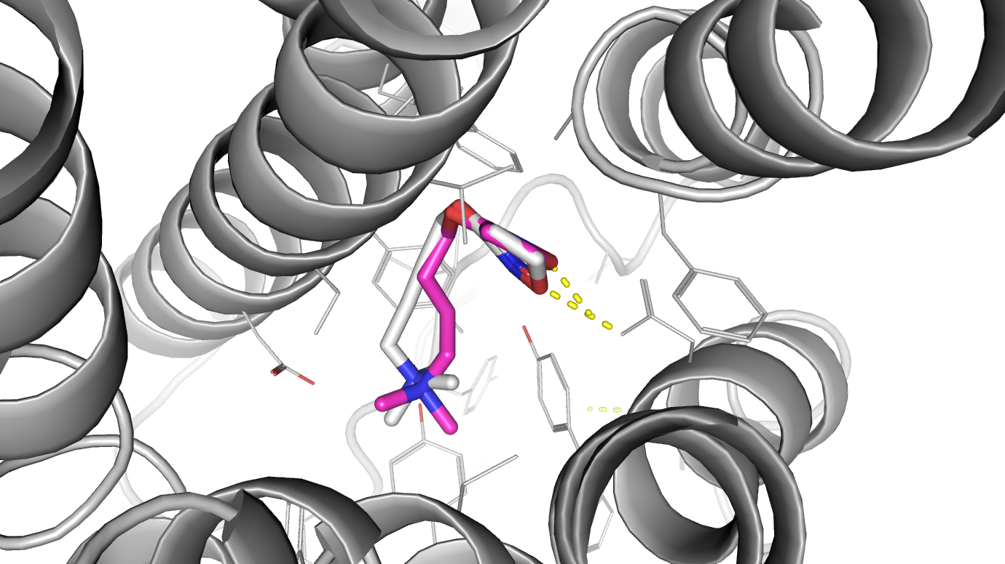
D103
Y403
Y426
Figure 31. Superposition of predicted complex from box Centered on Hetero with a reference complex (PDB ID: 4MQT). Receptor is represented as cartoon while X-ray and predicted ligand binding pose are represented as white and magenta sticks, respectively.

Slide 33
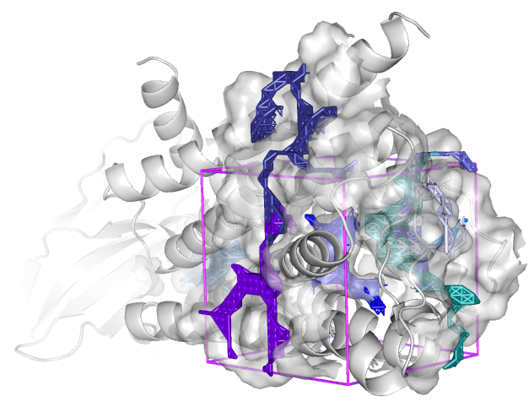
Figure 32. Automatic mode Search Space determination. The protein is represented gray cartoon. Each binding site predicted by AutoLigand is represented as transparent surface and contains an object represented as sticks. The box is shown in cylinders and magenta color.

Slide 34
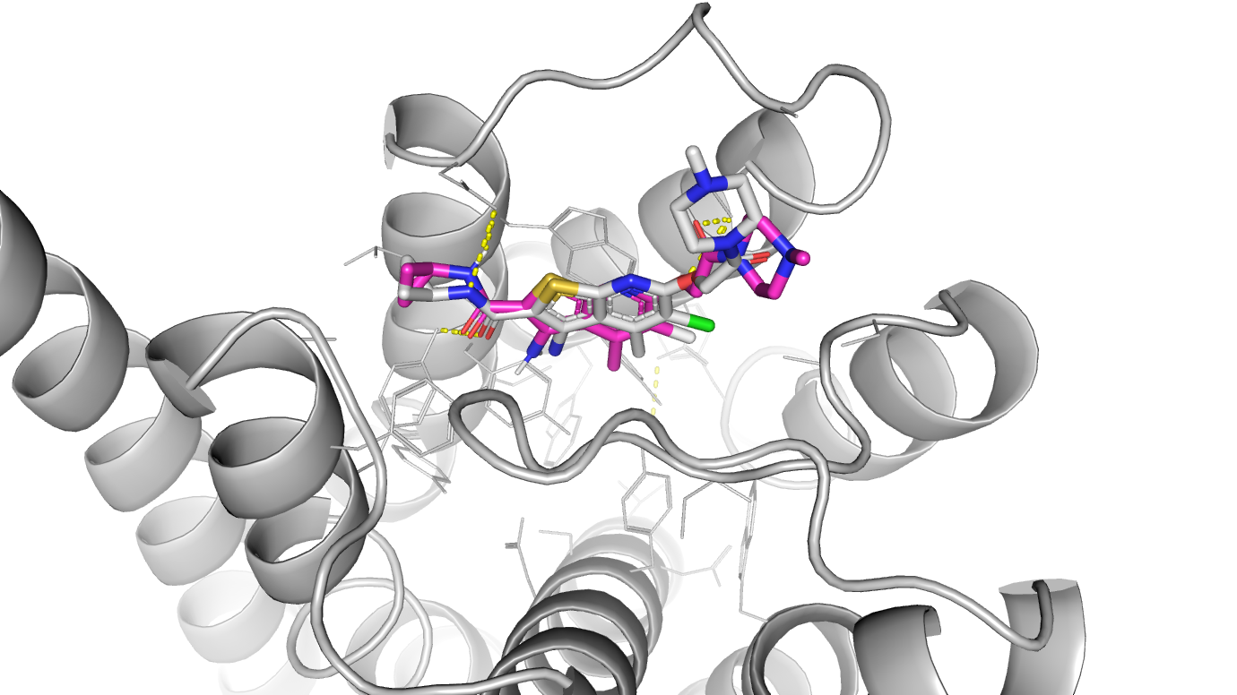
Figure 33. Predicted poses from Autodock Vina in magenta sticks.

Slide 35
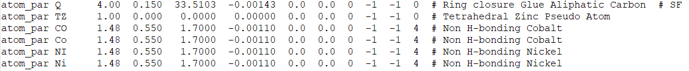
Figure 34. Fragment of AD4_customized parameter file showing all the parameter for Nickel atom

Slide 36
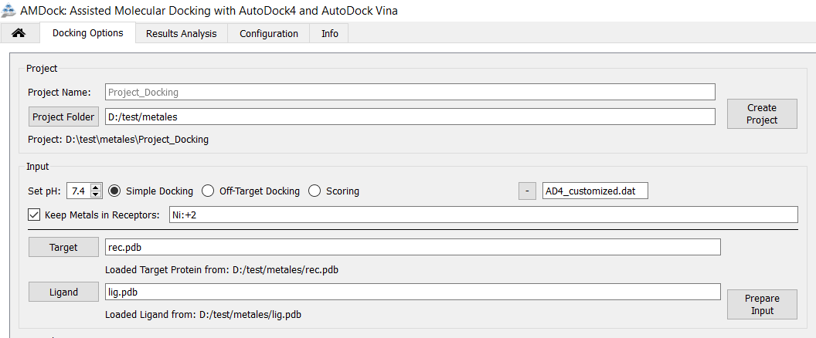
Figure 35. AMDock GUI

Slide 37
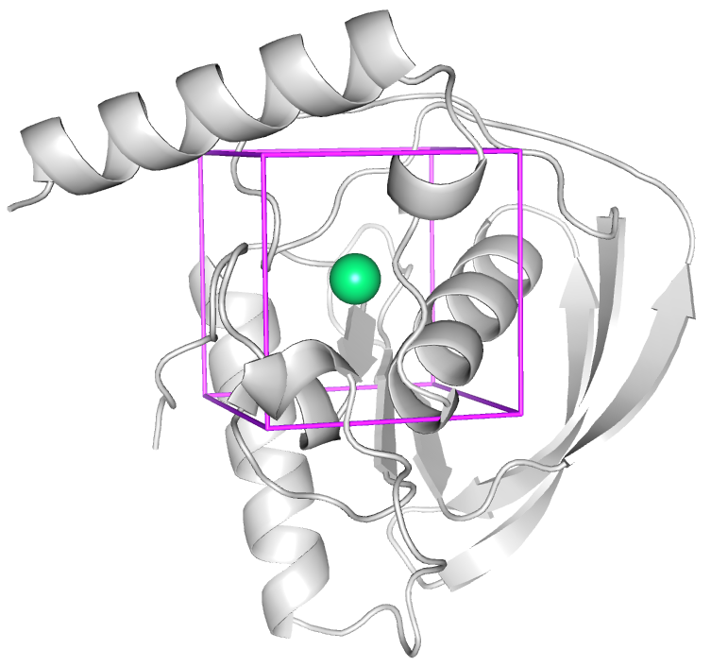
Figure 36. Box Centered on NI atom.

Slide 38
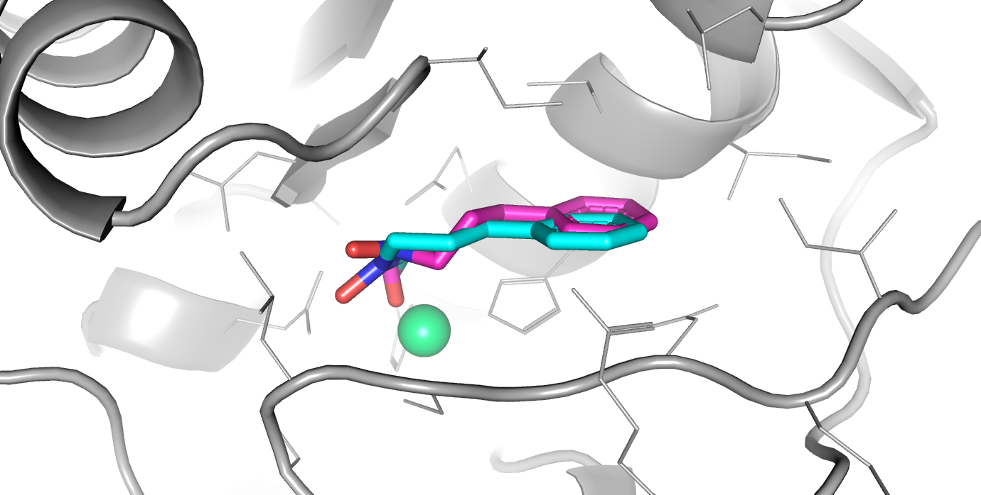
Figure 37. Predicted poses from Autodock4 in magenta sticks.

